Slide 1
Appendix A1 Introduction to Computers, Programs, and Java

Slide 2
Why Java?
The answer is that Java enables users to develop and deploy applications on the Internet for servers, desktop computers, and small hand-held devices. The future of computing is being profoundly influenced by the Internet, and Java promises to remain a big part of that future. Java is the Internet programming language.
Java is a general purpose programming language.
Java is the Internet programming language.

Slide 3
Java, Web, and Beyond
Java can be used to develop standalone applications.
Java can be used to develop applications running from a browser.
Java can also be used to develop applications for hand-held devices.
Java can be used to develop applications for Web servers.

Slide 4
Java’s History
James Gosling and Sun Microsystems
Oak
Java, May 20, 1995, Sun World
HotJava
The first Java-enabled Web browser
Early History Website:
http://www.java.com/en/javahistory/index.jsp

Slide 5
JDK Versions
JDK 1.02 (1995)
JDK 1.1 (1996)
JDK 1.2 (1998)
JDK 1.3 (2000)
JDK 1.4 (2002)
JDK 1.5 (2004) a. k. a. JDK 5 or Java 5
JDK 1.6 (2006) a. k. a. JDK 6 or Java 6
JDK 1.7 (2011) a. k. a. JDK 7 or Java 7
JDK 1.8 (2014) a. k. a. JDK 8 or Java 8
Java 9, 10, 11, 12, 13, 14, 15, 16, 17, 18.

Slide 6
JDK Editions
Java Standard Edition (J2SE)
J2SE can be used to develop client-side standalone applications or applets.
Java Enterprise Edition (J2EE)
J2EE can be used to develop server-side applications such as Java servlets, Java ServerPages, and Java ServerFaces.
Java Micro Edition (J2ME).
J2ME can be used to develop applications for mobile devices such as cell phones.
This book uses J2SE to introduce Java programming.

Slide 7
Popular Java IDEs
NetBeans
Eclipse

Slide 8
A Simple Java Program
Listing 1.1
// This program prints Welcome to Java!
public class Welcome {
public static void main(String[] args) {
System.out.println("Welcome to Java!");
}
}
Note: Clicking the green button displays the source code with interactive animation. You can also run the code in a browser. Internet connection is needed for this button.
Welcome

Slide 9
Trace a Program Execution
animation
Enter main method
// This program prints Welcome to Java!
public class Welcome {
public static void main(String[] args) {
System.out.println("Welcome to Java!");
}
}

Slide 10
Trace a Program Execution
animation
Execute statement
// This program prints Welcome to Java!
public class Welcome {
public static void main(String[] args) {
System.out.println("Welcome to Java!");
}
}

Slide 11
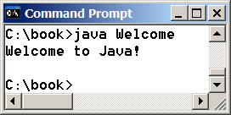
Trace a Program Execution
animation
// This program prints Welcome to Java!
public class Welcome {
public static void main(String[] args) {
System.out.println("Welcome to Java!");
}
}
print a message to the console

Slide 12
Two More Simple Examples
WelcomeWithThreeMessages
ComputeExpression

Slide 13

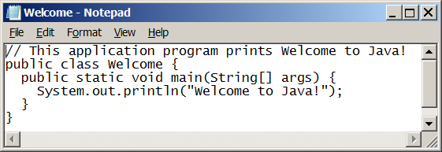
Creating and Editing Using NotePad
To use NotePad, type
notepad Welcome.java
from the DOS prompt.

Slide 14

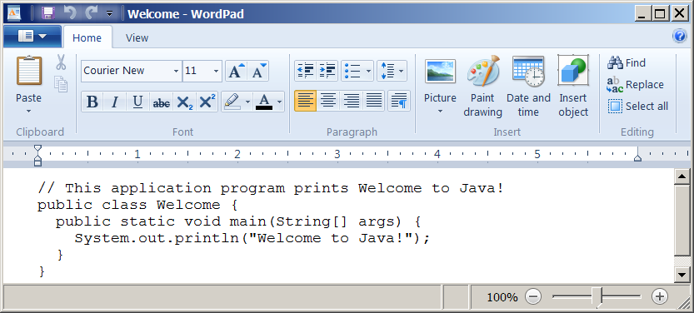
Creating and Editing Using WordPad
To use WordPad, type
write Welcome.java
from the DOS prompt.

Slide 15
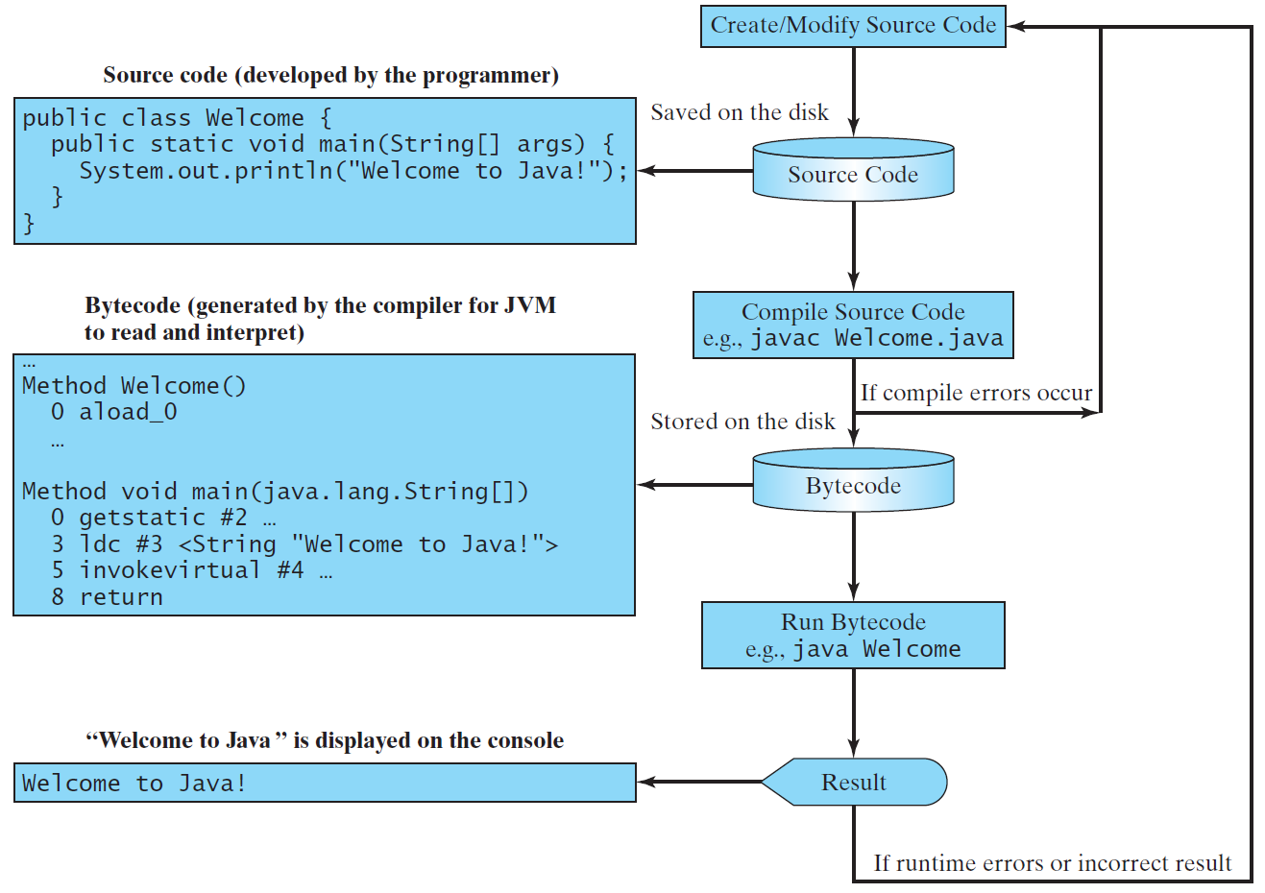
Creating, Compiling, and Running Programs

Slide 16
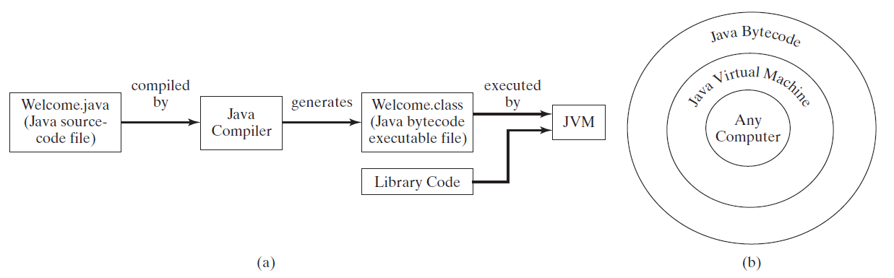
Compiling Java Source Code
You can port a source program to any machine with appropriate compilers. The source program must be recompiled, however, because the object program can only run on a specific machine. Nowadays computers are networked to work together. Java was designed to run object programs on any platform. With Java, you write the program once, and compile the source program into a special type of object code, known as bytecode. The bytecode can then run on any computer with a Java Virtual Machine, as shown below. Java Virtual Machine is a software that interprets Java bytecode.

Slide 17
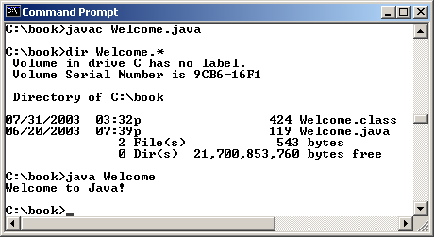
Compiling and Running Java from the Command Window
Companion Website
Set path to JDK bin directory
set path=c:\Program Files\java\jdk1.8.0\bin
Set classpath to include the current directory
set classpath=.
Compile
javac Welcome.java
Run
java Welcome

Slide 18
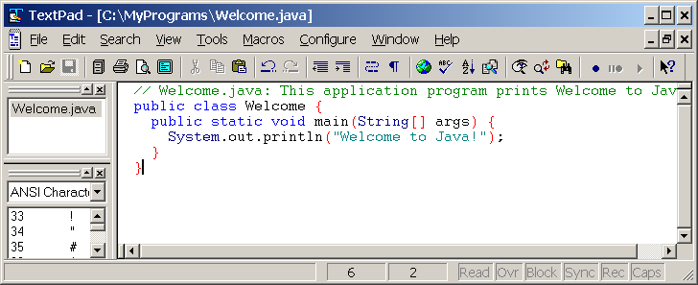
Compiling and Running Java from TextPad
Companion Website
See Supplement II.A on the Website for details

Slide 19
Anatomy of a Java Program
Class name
Main method
Statements
Statement terminator
Reserved words
Comments
Blocks

Slide 20
Class Name
Every Java program must have at least one class. Each class has a name. By convention, class names start with an uppercase letter. In this example, the class name is Welcome.
// This program prints Welcome to Java!
public class Welcome {
public static void main(String[] args) {
System.out.println("Welcome to Java!");
}
}

Slide 21
Main Method
Line 2 defines the main method. In order to run a class, the class must contain a method named main. The program is executed from the main method.
// This program prints Welcome to Java!
public class Welcome {
public static void main(String[] args) {
System.out.println("Welcome to Java!");
}
}

Slide 22
Statement
A statement represents an action or a sequence of actions. The statement System.out.println("Welcome to Java!") in the program in Listing 1.1 is a statement to display the greeting "Welcome to Java!“.
// This program prints Welcome to Java!
public class Welcome {
public static void main(String[] args) {
System.out.println("Welcome to Java!");
}
}

Slide 23
Statement Terminator
Every statement in Java ends with a semicolon (;).
// This program prints Welcome to Java!
public class Welcome {
public static void main(String[] args) {
System.out.println("Welcome to Java!");
}
}

Slide 24
Keywords
Keywords are words that have a specific meaning to the compiler and cannot be used for other purposes in the program. For example, when the compiler sees the word class, it understands that the word after class is the name for the class.
// This program prints Welcome to Java!
public class Welcome {
public static void main(String[] args) {
System.out.println("Welcome to Java!");
}
}

Slide 25
Blocks
A pair of braces in a program forms a block that groups components of a program.

Slide 26
Special Symbols

Slide 27
{ … }
// This program prints Welcome to Java!
public class Welcome {
public static void main(String[] args) {
System.out.println("Welcome to Java!");
}
}

Slide 28
( … )
// This program prints Welcome to Java!
public class Welcome {
public static void main(String[] args) {
System.out.println("Welcome to Java!");
}
}

Slide 29
;
// This program prints Welcome to Java!
public class Welcome {
public static void main(String[] args) {
System.out.println("Welcome to Java!");
}
}

Slide 30
// …
// This program prints Welcome to Java!
public class Welcome {
public static void main(String[] args) {
System.out.println("Welcome to Java!");
}
}

Slide 31
" … "
// This program prints Welcome to Java!
public class Welcome {
public static void main(String[] args) {
System.out.println("Welcome to Java!");
}
}

Slide 32
Programming Style and Documentation
Appropriate Comments
Naming Conventions
Proper Indentation and Spacing Lines
Block Styles

Slide 33
Appropriate Comments
Include a summary at the beginning of the program to explain what the program does, its key features, its supporting data structures, and any unique techniques it uses.
Include your name, class section, instructor, date, and a brief description at the beginning of the program.

Slide 34
Naming Conventions
Choose meaningful and descriptive names.
Class names:
Capitalize the first letter of each word in the name. For example, the class name ComputeExpression.

Slide 35
Proper Indentation and Spacing
Indentation
Indent two spaces.
Spacing
Use blank line to separate segments of the code.

Slide 36
Block Styles
Use end-of-line style for braces.

Slide 37
Programming Errors
Syntax Errors
Detected by the compiler
Runtime Errors
Causes the program to abort
Logic Errors
Produces incorrect result

Slide 38
Syntax Errors
public class ShowSyntaxErrors {
public static main(String[] args) {
System.out.println("Welcome to Java);
}
}
ShowSyntaxErrors

Slide 39
Runtime Errors
public class ShowRuntimeErrors {
public static void main(String[] args) {
System.out.println(1 / 0);
}
}
ShowRuntimeErrors

Slide 40
Logic Errors
public class ShowLogicErrors {
public static void main(String[] args) {
System.out.println("Celsius 35 is Fahrenheit degree ");
System.out.println((9 / 5) * 35 + 32);
}
}
ShowLogicErrors

